Slide 1

Obstacle avoiding robot
Marwan TAMER
amR Hany
Mohamed Mahfouz
Eyad Medhat

Slide 2
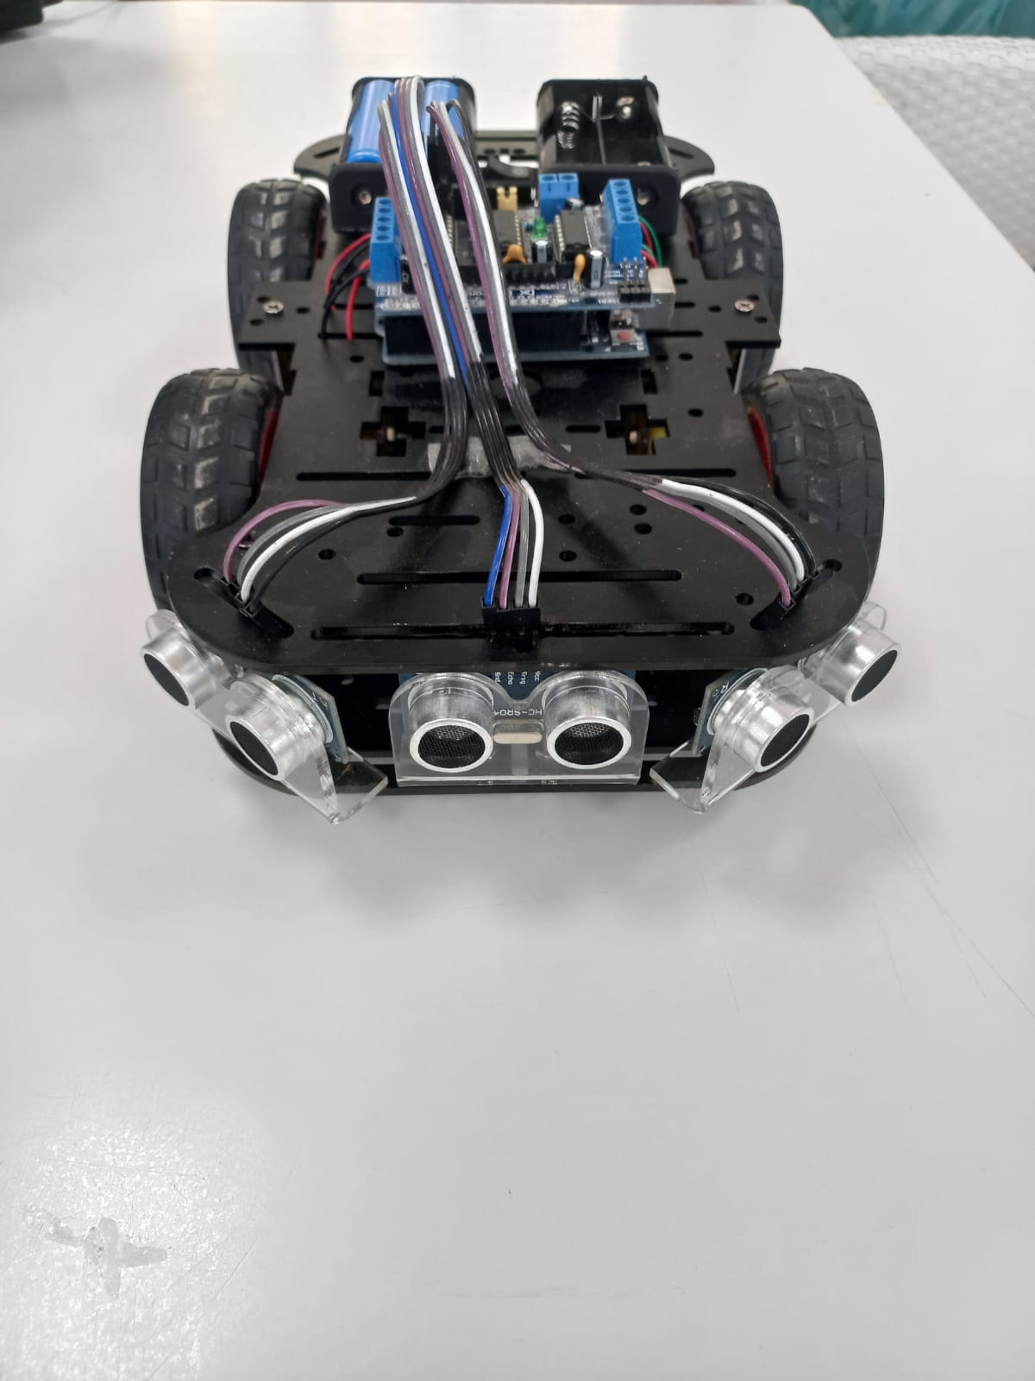

Slide 3
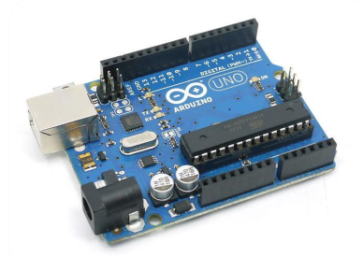
What’s Arduino?
Arduino boards are open-source electronics prototyping platforms which are widely used between both engineers and hobbyists to build DIY robots or any application that needs a microcontroller.

Slide 4
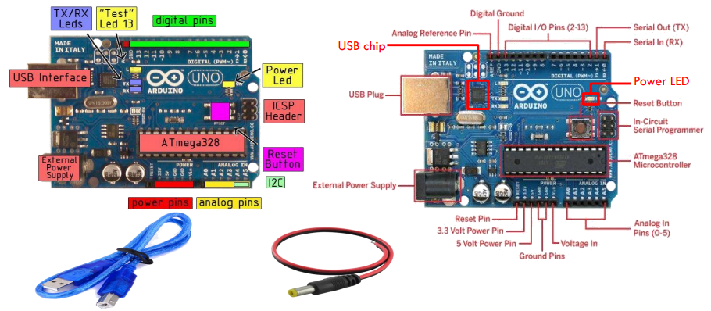
Arduino UNO

Slide 5
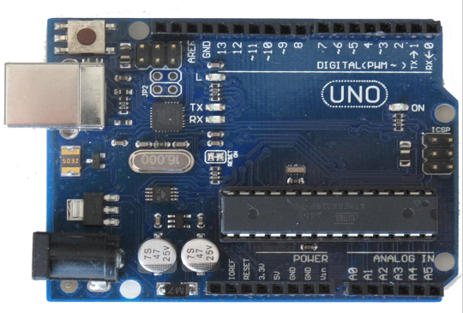
Arduino UNO
Digital inputs &output:
Analog inputs:
Analog output:
On or off (HIGH or LOW).
HIGH is 5VDC.
LOW is 0VDC.
A range of numbers.
0 to 1023 .
0.0049 V per digit (4.9 mV).
A range of numbers.
0 to 255.

Slide 6
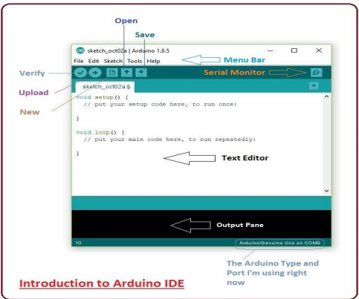
Arduino Software

Slide 7
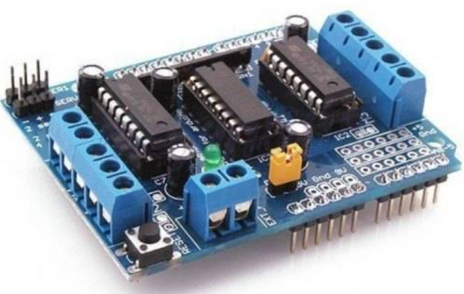
L293R Shield
The Arduino L293D motor driver shield guide is a robobtics project that involves driving various types of motors. The most common types used for robotic applications include DC, servo, and stepper motors.

Slide 8
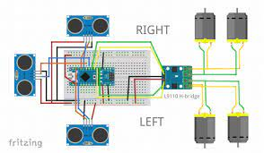
DC Motor
DC Motor is any of a class of rotary electrical motors that converts direct current electrical energy into mechanical energy.

Slide 9
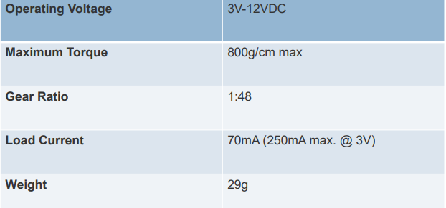
DC Motor Specification

Slide 10
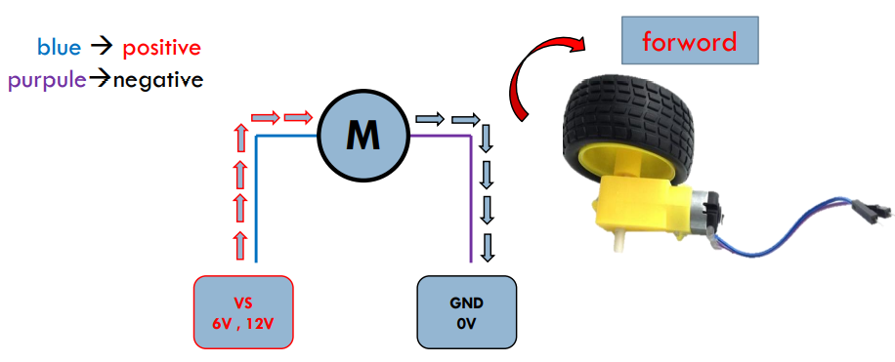
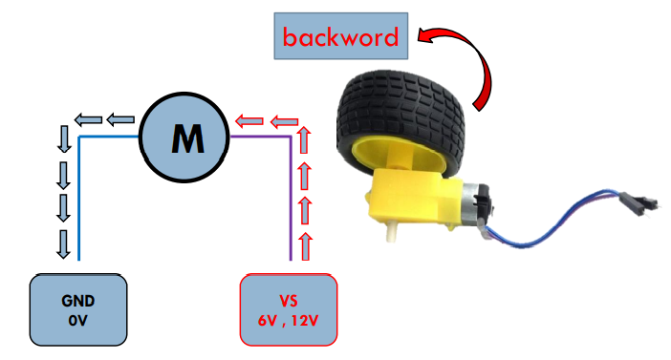
DC Motor principle

Slide 11
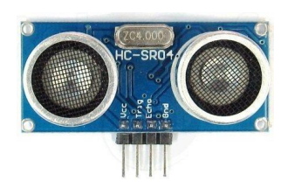
Ultrasonic sensor
The HC-SR04 ultrasonic sensor uses sonar to determine distance to an object like bats do.
Power Supply :+5V DC.
Ranging Distance: 2cm – 400cm.
Trigger Input Pulse width: 10uS.
waves are sound waves .

Slide 12
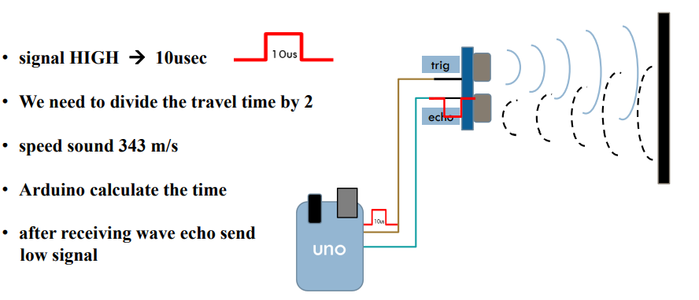
Ultrasonic principle

Slide 13
Obstacle avoiding robot (Wiring)

Slide 14
Thank you

